Slide 1






TECHTIDE
BY -
Achal Tyagi
Devanshi Gambhir
Ankit Kumar Yadav
Harsh Anand
Samyak Sakhare

Slide 2



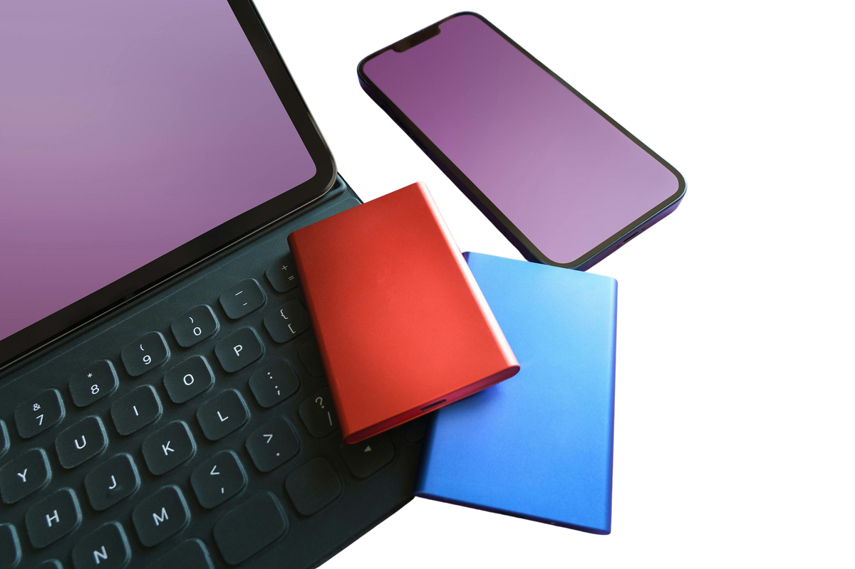
CERTI WIPE :
India generates 1.75M+ tonnes of e-waste annually, but fear of data breaches keeps many devices unused or discarded unsafely. Existing wiping tools are costly, complex, and lack proof, causing over ₹50,000 crore worth of IT assets to be hoarded. A simple, secure, and verifiable data wiping solution is urgently needed to enable safe recycling and reuse.

Slide 3



Behind Working
We see that the file which we delete is not deleted from the device but only the indexing is. But the thing which our software does, is that it exchange the previously saved data with the new one. So that even if the data is recovered, the data is that random data, not the original one.

Slide 4



The only thing this does is it overwrites the data and randomizes the data.

Slide 5
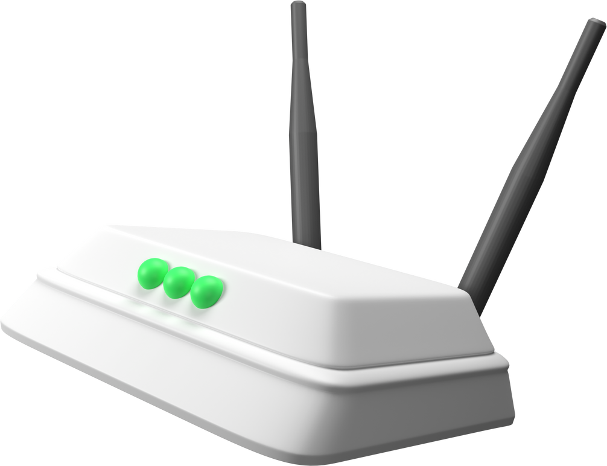
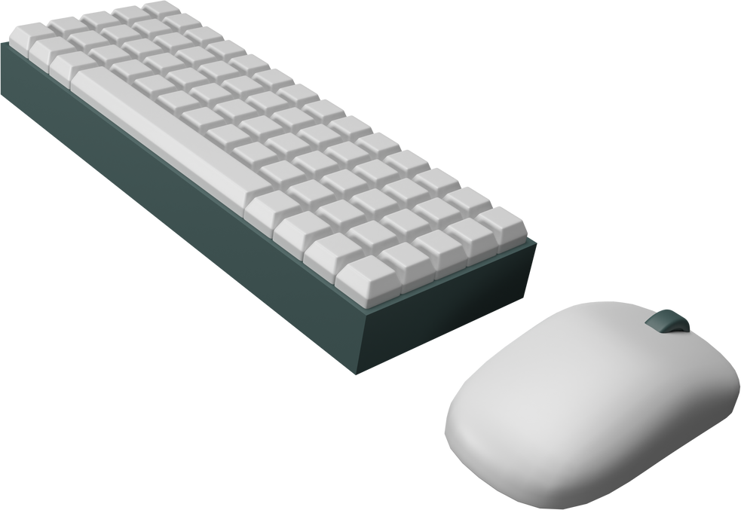
The Working
It overwrites the data with the randomised one which can be chosen from the options which it will list below. There are three options like overriding 3 times, one time and guntemm, which is 35 times.

Slide 6


Projection and Vision
Even if the person who tries to retrieve the data, he or she wont be able to as the indexing is already changed multiple times.

Slide 7
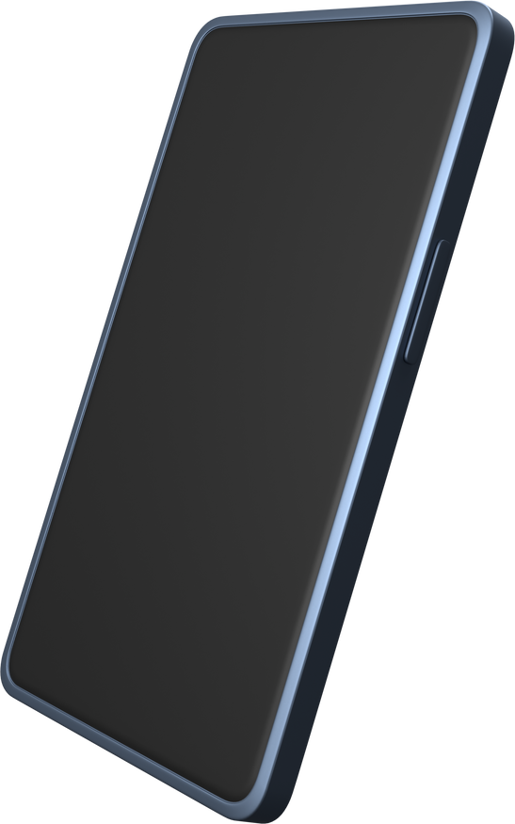
The Pocket Revolution
Smartphones represent the most personal form of technology. They combine countless tools into one device, shaping how we communicate, work, and express ourselves daily.

